Slide 1

Sparse Fourier transform Final Project Report
Andrii Hlyvko wentao zhu

Slide 2

abstract
(1).FFT is no longer fast enough.
(2).some signal is sparse(only small part of its spectrum is non-zero)
(3).(SFT) addresses the big data setting by computing a compressed
Fourier transform using only a subset of the input data, in time
smaller than the data set size.

Slide 3
The theoretical framework
The most common case for a signal :
(1) its spectrum is dominated by several non-zero frequencies
(2) some spectra of the frequencies are really close to each other.
Tricks to make signal to the simplest case:
(1)randomly binning the frequency
(2)filtering to isolate the frequency

Slide 4
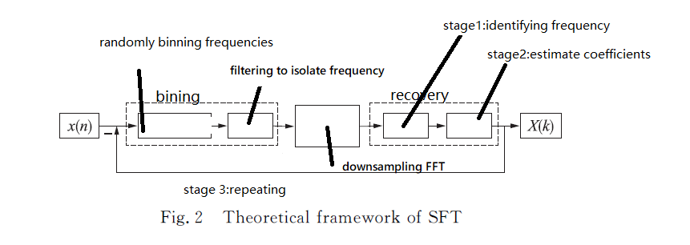
The theoretical framework

Slide 5
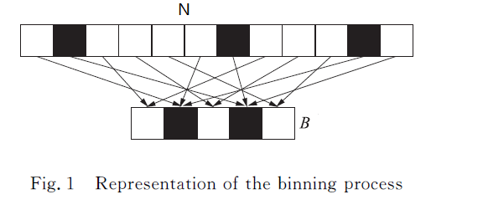

Slide 6
Theory
what we exactly do on each progress

Slide 7
Permutation is reversible
Based on (1)scaling property
(2)modulation property
randomly bin the frequency
completeness is guaranteed by Chinese Remainder Theorem

Slide 8
If we meet collided problem,we give up
Window function for frequency leakage
filtering to isolate frequency

Slide 9
Recovery
Phase Encoding
binary searching
aliased based search

Slide 10
Phase Encoding
It is derived from the OFDM trick.Suppose the single frequency signal
So we can easily get .But this method requires no noise in signal.
So we can easily get .But this method requires no noise in signal.

Slide 11
Binary Search
Need Lb N times to find the frequency and it has good robust to the noise

Slide 12
aliased based search
Suppose the length of a signal is N which could be represented by the multiplication of coprime integers.For example:N=2x5x7.
Let M be divisible by N.
(1)Randomly selected offset parameters;
(2)let
(3)do DFT to z(n) of M points to get Z(k)
(4)The 2K maximum coordinates of Z (k) are grouped into set T.
according to this formula we know that the non-zero value coordinate will appear in new set T in the form of k mod M.Set M into different value and we will get a set of formula and we can use Chinese remainder theorem to get the position of non-zero value.

Slide 13
The Prototypical SFT
step 1) identification of frequencies whose Fourier coefficients
are large in magnitude (typically a randomized subroutine).
Roughly speaking, stage 1 works by randomly binning the
Fourier coefficients of f into a small number of “bins” (i.e., frequency
bands), and then performing a single frequency recovery
procedure (as described in the section “Phase Encoding”) within
each bin to find any energetic frequencies that may have been
isolated there.
step 2) accurate estimation of the Fourier coefficients of the frequencies
identified in the first step
Recall that stage 2 involves estimating the Fourier coefficient of each frequency $\omega$ identified during stage 1 of the sparse FFT.
step 3) subtraction of the contribution of the partial Fourier representation
computed by the first two steps from the entries
of f before any subsequent repetitions.

Slide 14
simulation results of figure

Slide 15
simulation results of figure

Slide 16
conclusion
Now the SFT algorithm can only recovery the signal spectrum with a limited probability, and increasing the probability simply by increasing the number of iterations or iterations will sacrifice time complexity.It is not expected to be at the expense of increasing the computational complexity under the premise of improving the probability of reconstruction

